Slide 1
BTMW 4012 TECHNOPRENEURSHIP LECTURE 5 MARKETING

Slide 2
Introduction
Kotler (2014) defines marketing as “the science and art of exploring, creating, and delivering value to satisfy the needs of a target market at a profit. Marketing identifies unfulfilled needs and desires”. This chapter focuses on the basic knowledge about principles of marketing and some of the approaches applicable for start-ups and small business companies.

Slide 3
Important Concepts in Marketing—Needs, Wants, Demand, Values and Satisfaction
An entrepreneur must understand the target customers in terms of needs, wants and demands, so he can develop products or services that are of value to the customers.
He may have to invest in information gathering and analysis which will enable him to understand his customer’s motivation and behaviour. This will help develop marketing strategies and tactics that are suitable and fit the customers’ characteristics.

Slide 4
Important Concepts in Marketing—Needs, Wants, Demand, Values and Satisfaction (cont.)
“Needs” refer to a person’s feelings of a state of inadequacy.
“Wants” refer to what a customer desires beyond basic needs. “Wants” are often influenced by many factors, i.e. psychographics, demographics, economics and cultural factors.
“Demands” refer to the needs and wants that can be translated into real purchases by customers because they can afford it and are willing to pay for it.

Slide 5
Important Concepts in Marketing—Needs, Wants, Demand, Values and Satisfaction (cont.)
“Value” is the benefit received when buying a product or service. “Price” is what is paid for a product or service. Customers will be easily persuaded to part with their money to buy something if they perceive it to have greater value than what it cost them to buy.
Therefore, a marketer will try to package his products, price, promotion, distribution channels and selling outlets to suit and fit the target market customers and to make them consider it to be of higher value than its price.

Slide 6
Important Concepts in Marketing—Needs, Wants, Demand, Values and Satisfaction (cont.)
Customer satisfaction is very important as it will translate into repeated sales.
Satisfied customers contribute to sales growth because they will promote the products (word-of-mouth) to friends and family.

Slide 7
Market Segment, Target Customers and Positioning
In the marketplace, sellers compete with each other to sell to customers. A marketer needs to identify the target customers. One may divide potential customers into segments of customers that share common characteristics.
This practice may facilitate the entrepreneur to package suitable marketing strategies that suit customers’ characteristics.

Slide 8
Market Segment, Target Customers and Positioning (cont.)
“Positioning” refers to how customers perceive a brand or a company and its offerings as compared to other company’s offerings.
Customers’ perceptions can also be influenced by how a company communicates and projects its image to the customers. Some companies use taglines to position, reflect and differentiate their products from competitors’ product. For example, Subway restaurants use “Eat Fresh” as their tagline to show them as a restaurant selling fresh products.

Slide 9
MARKET CATEGORIES
Category | Profiles
Human Being | Geographic Demographic Psychographic
Government | Local Government State Government Federal Government
NGOs | Environment Social Cultural
Business Entity | Manufacturer Wholesaler Agent/Dealer Retailer

Slide 10
MARKET SEGMENTATION
Segmentation | Variables/Bases
1. Geographic | District Residency Division State Country Climate
2. Demographic | Age Occupation Gender Education Income Social Class Family Race Sub culture
3. Psychographic | Personal taste Status Preferences Ego Hobbies Political attitude Sensitivity to price Motives of purchase Loyalty to product

Slide 11
Customer Relationship Management (CRM)
Customer relationship management or customer relationship marketing is focused on building relationships with existing customers to turn them into loyal customers.
The objective of relationship marketing is to build a win-win and satisfying relationship with the customers.
Researches have shown that it is less expensive to maintain current customers and develop good relationships with them.

Slide 12
Marketing Plan
Successful marketers usually develop a marketing plan as their road map. The plan serves as a guideline to specific analysis, marketing strategies, tactics and programmes.
A marketing plan requires data collection and analysis of customers, competitors and marketing environment. Based on this, realistic and suitable marketing objectives, strategies and marketing budget are outlined for implementation.

Slide 13
Marketing Mix
Marketing mix refers to marketing strategies, commonly known as 4Ps, i.e. strategies of product, price, promotion and place.

Slide 14
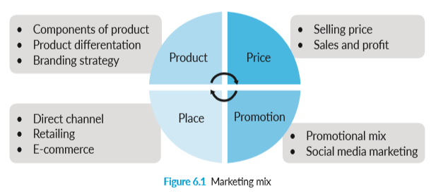
Marketing Mix (cont.)

Slide 15
Product
Marketers develop product strategies that can create and provide values to target customers. Among product strategies that need to be developed include components of a product, branding, packaging, and other elements that add value to the core product.
Components of a product include the core function of a product, plus other elements that can add value to the product, such as innovative design, extended warranty, after sales service, etc.

Slide 16
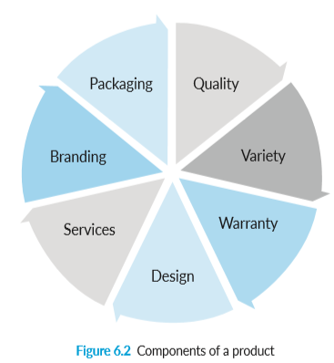
Product (cont.)

Slide 17
Price
The marketer needs to plan prices in such a way that customers can afford to pay, are willing to pay, and the price can provide a profit margin.
Price can be fixed based on a number of strategies:
Cost-based pricing, i.e. cost plus targeted profit margin.
Value-based pricing, i.e. based on customers intrinsic value evaluation and perception.
Competitor-based pricing, i.e. price is fixed relative to competitor’s price.
All of the above.

Slide 18
Promotion
Promotion in general refers to how marketers communicate with customers.
However, in today’s business environment, it is not only important for marketers to communicate with customers and potential customers, but it is also crucial that marketers communicate with suppliers, distributors, competitors and at the same time, provide avenues for customers to communicate with each other.

Slide 19
Promotion (cont.)
Promotional strategies involve the use of sales promotion, advertising, public relations, publicity, direct marketing, personal selling and social media marketing.
Sales promotion is commonly used to entice or persuade customers to buy within a short period of time. Examples of sales promotion include contests, price reductions, rebates, and coupons.

Slide 20
Promotion (cont.)
Advertising is communication from the marketer to the target audience through medium such as printed, electronic, outdoor and online advertising. The objectives of advertising can be to persuade, to remind or to inform the target audience about products and/or about the firm.
However, a marketer’s challenge is always to identify a promotional method that is cost effective, i.e. to achieve maximum impact at the lowest possible price.

Slide 21
Promotion (cont.)
With the advancement of telecommunication technologies, promotional strategies today are more innovative and can reach audiences 24/7 all over the world.
Social marketing use the Internet as a platform to communicate with stakeholders and customers.
Popular social media instruments include Instagram, Twitter, Facebook and interactive websites and are most commonly used today.

Slide 22

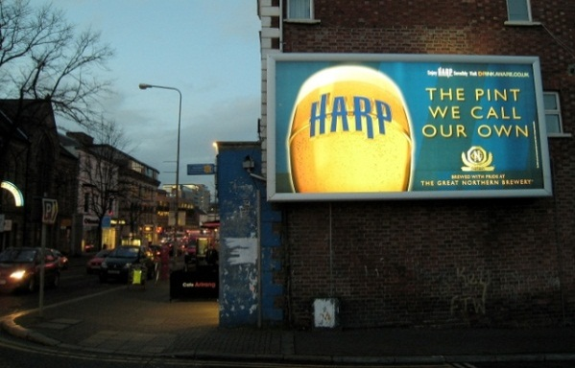


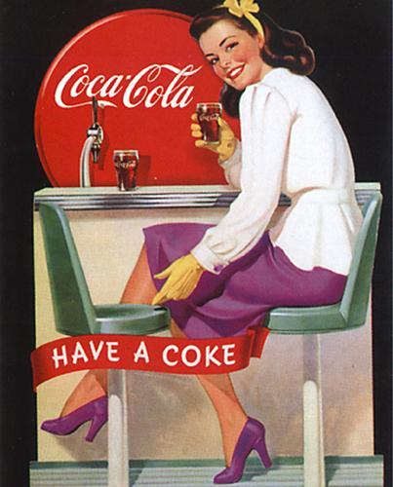

PROMOTION STRATEGY (2)
Example Advertising

Slide 23
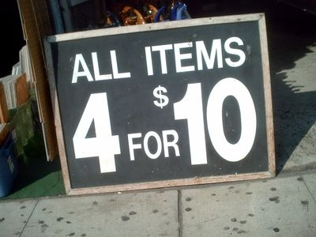
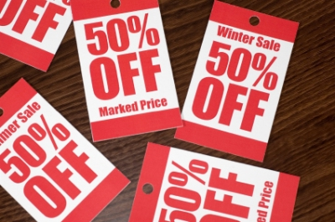
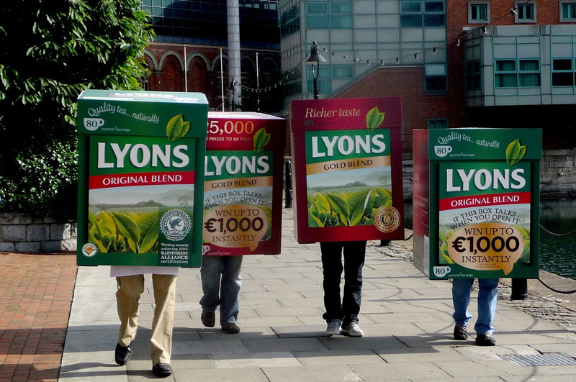
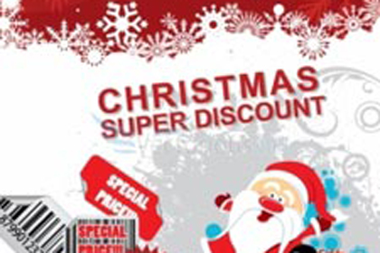
PROMOTION STRATEGY (3)
Example of Promotion

Slide 24
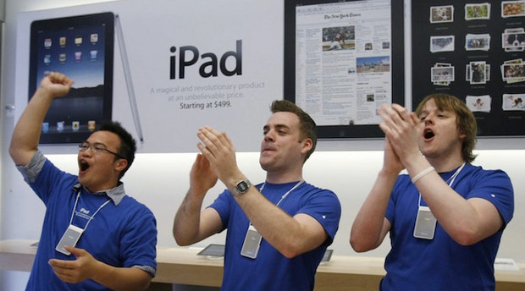
PROMOTION STRATEGY (4)
Example of Public Relation/Publicity

Slide 25
Place
Place is the strategy to make products available and accessible to target customers. A producer has to make the decisions on how to deliver products to customers.
Important functions that need to be performed in any type of channel of distribution includes selling, providing information, logistics, research, financing, etc.
Direct channel is where producers deliver products to customers directly without a middleman. One of the fastest-growing direct sales distribution method is online sales (through Internet).

Slide 26
Marketing and Entrepreneurship
In general, marketing is a business approach that is based on principles of understanding customers, delivering values to satisfy customers, and doing it at a profit.
The implementation of effective marketing strategies (4Ps) reflects a firm’s understanding of its target customers’ needs and wants. However, marketing today is becoming more interesting and challenging.

Slide 27
Marketing and Entrepreneurship (cont.)
For example, many young entrepreneurs are involved in online businesses, services and mobile applications. Thus, entrepreneurs need to be creative and willing to take risks in developing new ways of marketing new products/services to target customers.

Slide 28
STEPS IN SALES FORECASTING
Determine Market Size
Identify the Competitors
Estimate Market Share
Forecast Sales :
Customer Awareness Of The Existence Of The Business
Seasonal Factors
Pre-Sales Period

Slide 29
MANAGING MARKETING ACTIVITIES
The Gann Chart
No. | ACTIVITIES | MONTH
 |  | 1 | 2 | 3 | 4 | 5 | 6 | 7 | 8 | 9 | 10 | 11 | 12
1 | General briefing to personnel
2 | Advertising & promotion launched
3 | Departmental coordination
4 | Briefing for all distribution channel
5 | Sales visits
6 | Monitoring & corrective actions
7 | Consolidation

Slide 30
MANAGING MARKETING ACTIVITIES (2)
The Marketing Budget
ITEMS | FIXED ASSETS EXPENSES (RM) | MONTHLY EXPENSES (RM) | OTHER EXPENSES (RM)
Signboard Marketing Personnel Salary Commission EPF/SOCSO Travelling Promotion Grand Opening | 300 | 5,000 5,000 1,000 2,000 | 10,000 5,000
Total | 300 | 13,5000 | 15,000

